Slide 1

End-to-end deep learning
What is
end-to-end
deep learning
deeplearning.ai

Slide 2
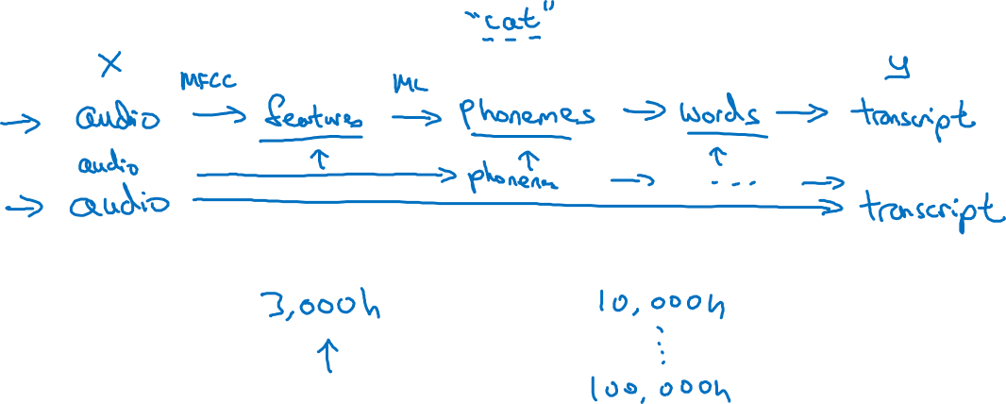
What is end-to-end learning?
Speech recognition example

Slide 3
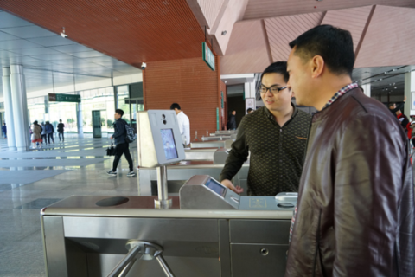
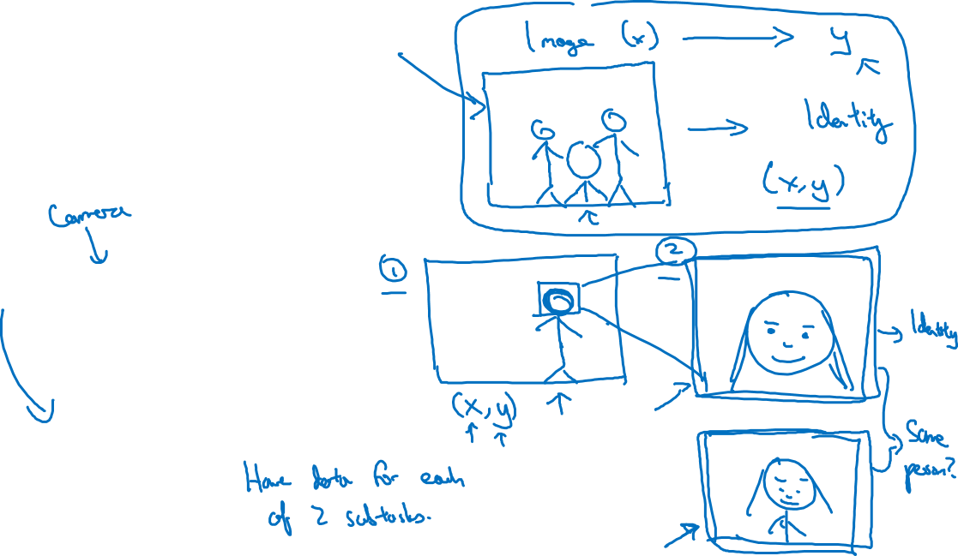
Face recognition
[Image courtesy of Baidu]

Slide 4
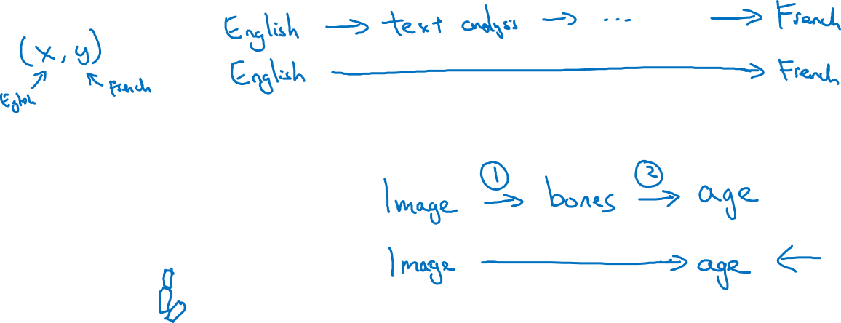
More examples
Machine translation
Estimating child’s age:

